Slide 1
Application Security
Brian Ombongi - OSCP
Application Security Analyst
May 10, 2022

Slide 2
Objectives
Why Application Security
Web Application Testing
OWASP Top 10
Demo
Securing Web Applications
Learning Resources
Notes:
What we will cover
What we won’t cover
Set expectations
Questions / Comments

Slide 3


Slide 4
Security Types
Web, API, Mobile
Application Security
Cloud Security
Critical Infrastrucure Security
IoT Security
Network Security
Electric grid, water purification, Traffic lights, hospitals etc
The ‘s’ in IoT stands for Security
Securing internal networks.
84% of attacks happen at the Application Layer

Slide 5
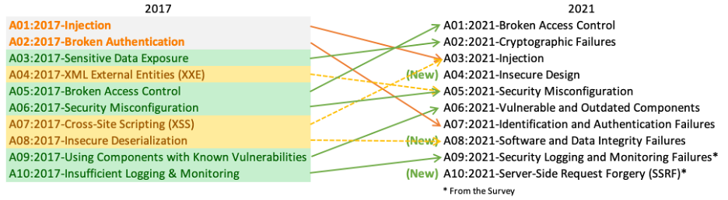
Web Application Security Risks – OWASP

Slide 6
The Trinity of Trouble
Connectivity
Reusability
Complexity
Notes:
Connectivity : IoT
Complexity – Microservices, APIs, serverless, stitched together
Reusability - OOP

Slide 7
A01 : Broken Access Control

Slide 8
A01 – Broken Access Control
Definition
Gaining unauthorized access and privileges (API1:2019 Broken Object Level Authorization)
Gaining unauthorized access to user accounts and act as administrators or regular users.
Users having unauthorized privileged functions.
How?
Insufficient segregation between users.
Forced browsing to authenticated pages.
CORS misconfigurations leading to unauthorized API access.
Privilege escalation, e.g., admin = true; cookie.
Metadata manipulation e.g. replaying or tampering with JSON web tokens (JWT) or manipulating hidden fields.

Slide 9
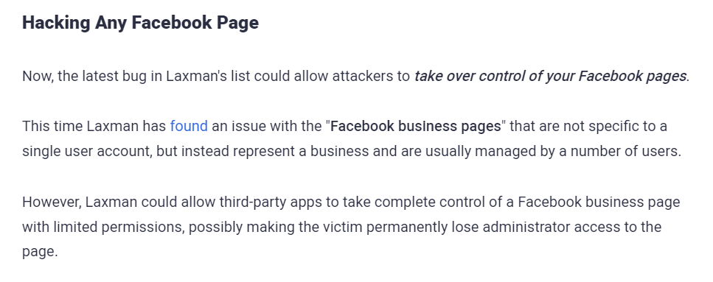
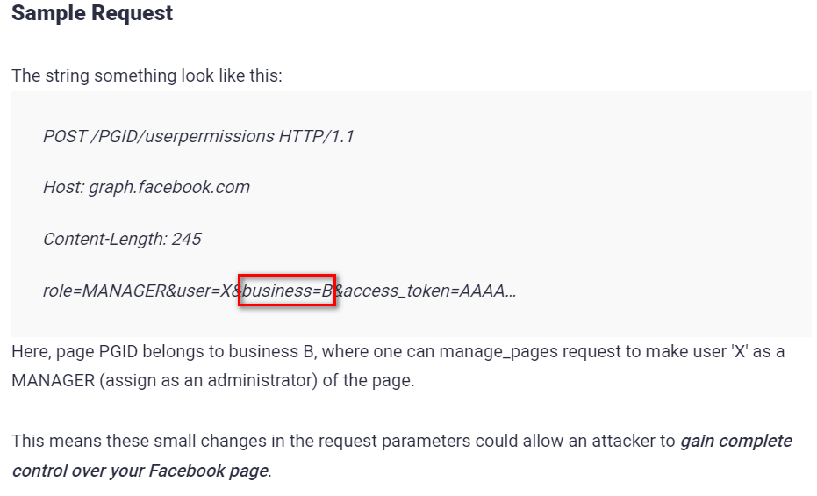
A01 – Broken Access Control

Slide 10
A01 – Mitigation
Implement a proper authorization mechanism that relies on the user policies and hierarchy.
Use an authorization mechanism to check if the logged-in user has access to perform the requested action on the record in every function that uses an input from the client to access a record in the database.
Prefer to use random and unpredictable values as GUIDs for records’ IDs.
Relying on established authentication systems.
Proper Security Monitoring & Logging to detect violations, e.g,. Repeated failures.
Implement a deny by default access strategy.
Disable directory listing.
Ensure sensitive files are not present on web roots, e.g .git, .svn
Implementing proper rate limiting.

Slide 11
A02 : Cryptographic Failures

Slide 12
A02 : Cryptographic Failures
Definition
Cryptography is the discipline of securing communications.
Concerned with : Confidentiality, Non-Repudiation, Integrity & Authenticity
Typically, attackers steal cryptographic keys rather than attacking directly.
Flaws are related to :
Not encrypting sensitive data (Transit & rest).
Weak key generation & Management
Weak hashing algorithm use.
Still, some weak algorithms can be broken into.
Improper data classification can lead to improper handling.
Improper use of cryptography.
Improper randomization of salts, IVs, etc
Security through obscurity

Slide 13
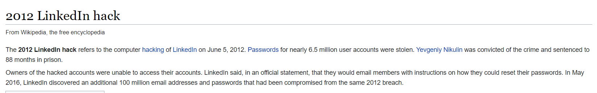
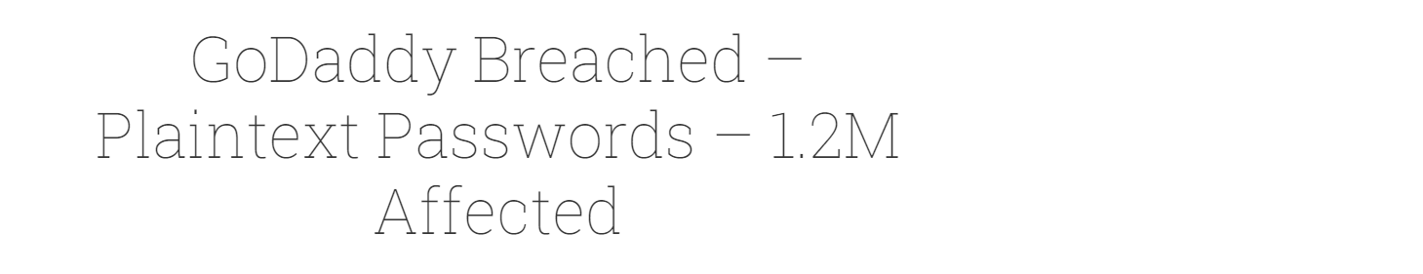
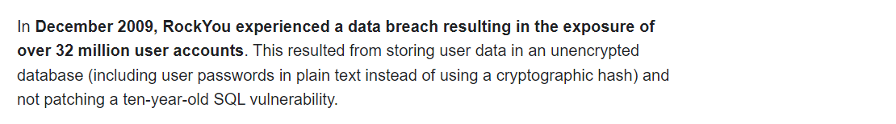
A02 – Cryptographic Failures

Slide 14
A02 : Mitigation
Proper encryption, at rest and in transit.
Disable caching for content containing sensitive data.
Proper salting and hashing of passwords
Avoid legacy protocols when transmitting data.
Avoid deprecated cryptographic functions and padding schemes, such as MD5, SHA1.
Ensure up-to-date and strong standard algorithms, protocols, and keys are in place; use proper key management.
Proper data classification.
Etc…

Slide 15
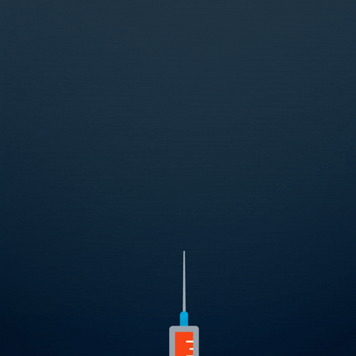
A03 : Injection

Slide 16
A03 : Injection
Definition
Injection flaws occur when untrusted data is sent to an interpreter as part of a command or query. Examples include:
SQL Injection
XSS
OS Injection
LDAP Injection
XML Injection
More….a lot more..
How :
Attacker identifies attack vector.
Dynamic or manual analysis.
Attacker crafts malformed input/request e.g. malformed SQL query.
Profit

Slide 17
A03 : Injection – SQL Example
Vulnerable Statement
SELECT * FROM users WHERE name = ‘ “ + username + “ ‘;
Setting ‘username’ to
‘ or ‘1’=‘1
‘ or ‘1’=‘ - - ‘
Renders the following SQL:
SELECT * FROM users WHERE name = ‘ ‘ OR ‘1’ = ‘1’ ;
SELECT * FROM users WHERE name = ‘ ‘ OR ‘1’ = ‘1’ – ‘ ;
Can also lead to more malicious activities:
SELECT * FROM users WHERE name = ‘ a‘; DROP TABLE users’ ;

Slide 18
A03 : Injection – Command Injection
int main(char* argc, char** argv) {
char cmd[CMD_MAX] = “ /usr/bin/cat ";
strcat(cmd, argv[1]);
system(cmd);
}
An attacker can supply “; rm –rf /” which will recursively delete the root disk.
“; ” terminates the first part of the command, allowing the second part to run, i.e. “rm –rf /” .

Slide 19
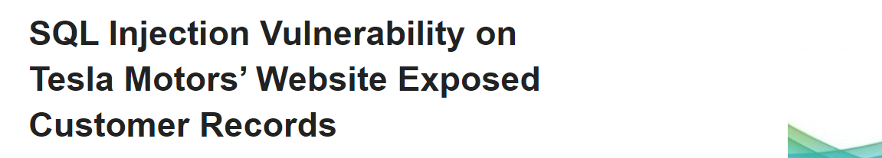
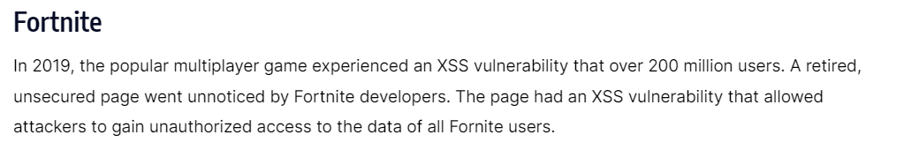
A03 – Injection

Slide 20
A03 : Injection - Mitigation
Mitigation depends on the type of Injection
Generally :
Avoid system calls and user input—to prevent threat actors from inserting characters into the OS command
Set up input validation—to prevent attacks like XSS and SQL Injection.
Carry out proper output sanitization.
Create a white-list of all possible inputs. – Not applicable in all scenarios
Apply principle of least privilege.
Use safe API’s
Etc…

Slide 21
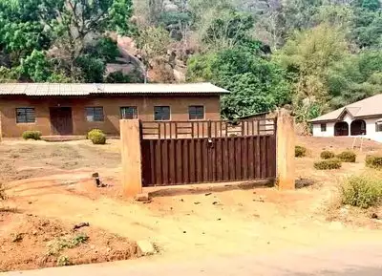
A04 : Insecure Design

Slide 22
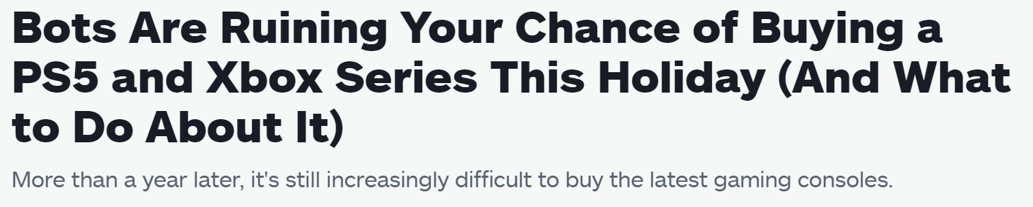
A04 : Insecure Design
A new category for 2021
Focuses on risks related to design and architectural flaws.
Moving beyond ‘shifting left’ to pre-code activities.
Threat Modelling
CWE-502: Trust Boundary Violation
Examples
Lack of rate limiting on limited products.

Slide 23
A04 : Threat Modelling
Seeks to answer :
What are we working on?
What can go wrong?
What are we going to do about it?
Did we do a good job?
STRIDE threat Model:
Spoofing – (Authentication) - Pretending to be someone else
Tampering – (Integrity) - Modification of data
Repudiation – (Non-Repudiation) – Denying preforming an action
Information Disclosure – (Confidentiality) - Leakage of information
Denial of Service – (Availability) – Resource exhaustion
Elevation of Privilege – (Authorization) – Performing unauthorized actions

Slide 24
A04 : Insecure Design - Mitigation
Implement SDLC with AppSec professionals to evaluate and design security and privacy-related controls.
Use a library of secure design patterns or paved road ready to use components.
Use threat modeling for critical authentication, access control, business logic, and key flows.
Integrate security language and controls into user stories
Integrate plausibility checks at each tier of your application (from frontend to backend)
Write unit and integration tests to validate that all critical flows are resistant to the threat model. Compile use-cases and misuse-cases for each tier of your application.
Etc..

Slide 25
A05 : Security Misconfiguration

Slide 26
A05 : Security Misconfiguration
Definition
Moves up from 6th.
Notable CWEs include :
CWE-16 Configuration
CWE-611 Improper Restriction of XML External Entity Reference.
How :
Not properly implementing security hardening across the application stack.
Unnecessary features are enabled or installed (e.g., unnecessary ports, services, pages, accounts, or privileges).
Default accounts and their passwords are still enabled and unchanged.
Improper error handling.
For upgraded systems, the latest security features are disabled or misconfigured.
The server does not send security headers or directives, or they are not set to secure values.
The software is out of date or vulnerable

Slide 27
A05 : XXE – XML External Entity
What is XML
Extensible Markup Language : Designed for storing and transporting data
What is XML Entities
XML entities are a way of representing an item of data within an XML document, instead of using the data itself. For example, the entities &lt; and &gt; represent the characters < and >.
What is Document Type Definition
A DTD defines the structure and the legal elements and attributes of an XML document.
The DTD is declared within the optional DOCTYPE element at the start of the XML document.
What are XML custom entities?
XML allows custom entities to be defined within the DTD (within the XML document). For example:
<!DOCTYPE foo [ <!ENTITY myentity "my entity value" > ]>
This definition means that any usage of the entity reference &myentity; within the XML document will be replaced with the defined value: "my entity value".

Slide 28
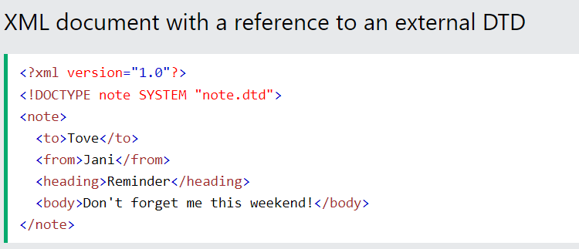
A05 : XXE – XML External Entity …
What are XML external entities?
XML external entities are a type of custom entity whose definition is located outside of the DTD where they are declared.
The declaration of an external entity uses the SYSTEM keyword and must specify a URL from which the value of the entity should be loaded. For example:
<!DOCTYPE foo [ <!ENTITY ext SYSTEM "http://normal-website.com" > ]>
https://www.w3schools.com/xml/xml_dtd_intro.asp

Slide 29
A05 : Security Misconfiguration - Mitigation
A repeatable hardening process makes it fast and easy to deploy another environment
A minimal platform without any unnecessary features, components.
A task to review and update the configurations appropriate to all security notes, updates, and patches as part of the patch management process.
A segmented application architecture .
Sending security directives to clients, e.g., Security Headers.
An automated process to verify the effectiveness of the configurations and settings in all environments.

Slide 30

Break

Slide 31

A06 : Vulnerable & Outdated Components

Slide 32
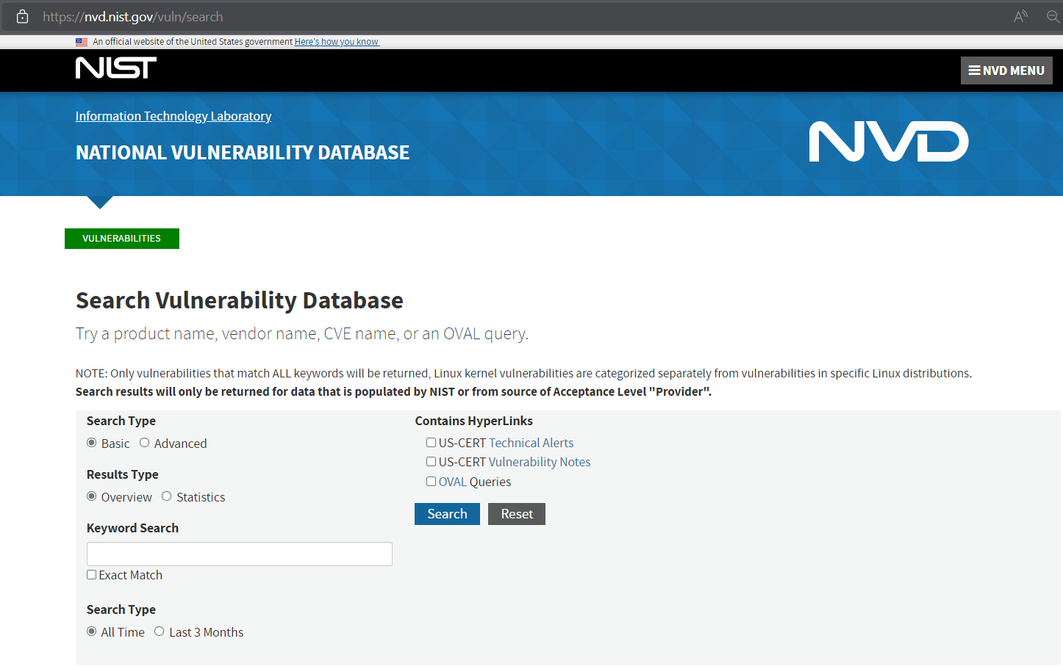
A06 : Vulnerable & Outdated Components
Using components with known vulnerabilities.
https://nvd.nist.gov/vuln/search

Slide 33
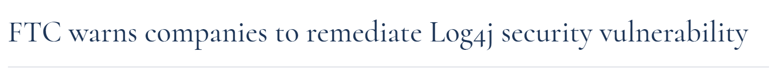
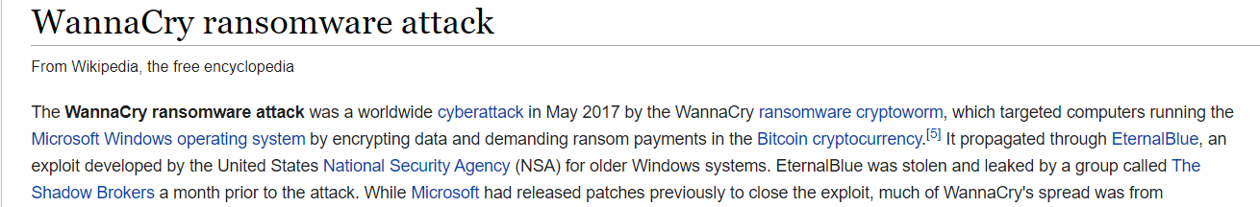
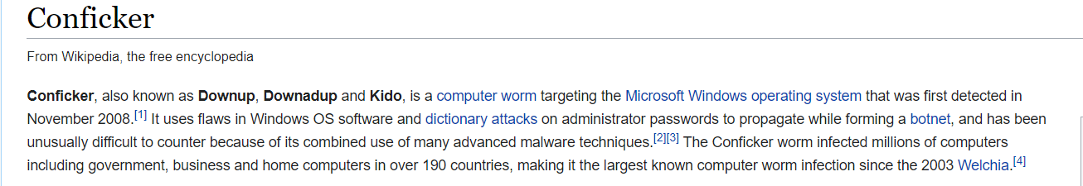
A06 – Vulnerable & Outdated Components

Slide 34
A06 : Mitigation
Proper asset inventory
Establish a proper PVMG process.
Maintain a minimal platform. Remove unnecessary features.
Sending proper security directives, e.g. security headers , to clients
Proper segmentation.
Periodic health checks on security infrastructure.
Obtain software from trusted sources.

Slide 35
A07 : Identification and Authentication Failures

Slide 36
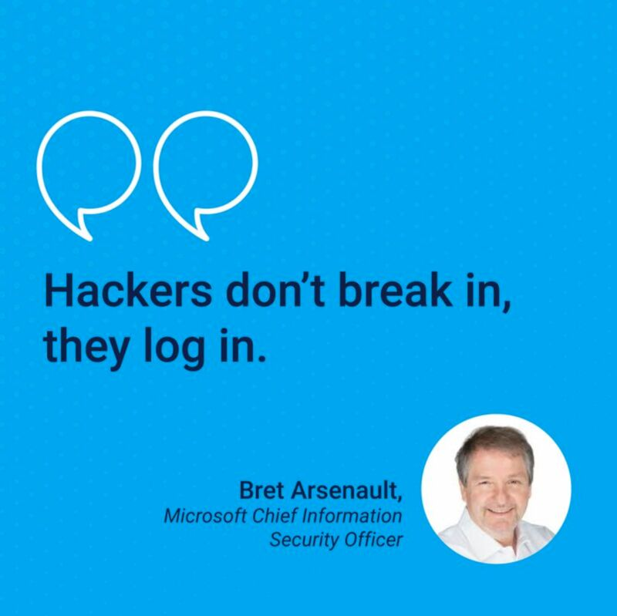
A07 : Identification and Authentication Failures
API02 : Broken User Authentication
Include any security problem related to user identities.
Brute force or other automated attacks.
Exposing session identifier in the URL.
Missing or ineffective multi-factor authentication.
Not invalidating session IDs after logout.
Weak/default credentials.
Credential stuffing attacks.
Hard coding credentials

Slide 37
A07 : Mitigation
MFA, MFA, MFA, MFA
Remove default credentials.
Implement weak password checks.
Have proper password length, complexity & rotation policies.
Properly implement rate limiting.
Ensure registration, credential recovery, and API pathways are hardened against account enumeration attacks.
Implement a proper session management system.
Don’t implement your own authentication system – Where possible.
..
..

Slide 38
A08 : Software and Data Integrity Failures

Slide 39
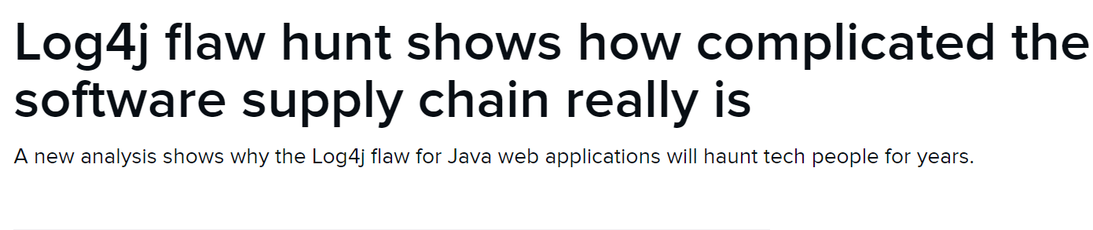
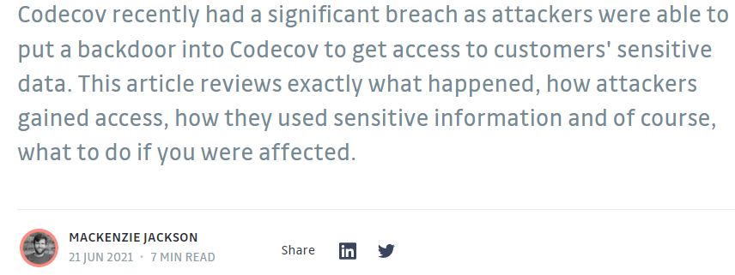
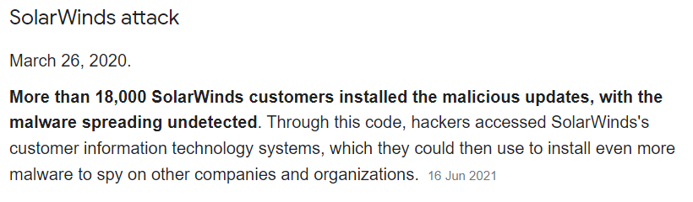
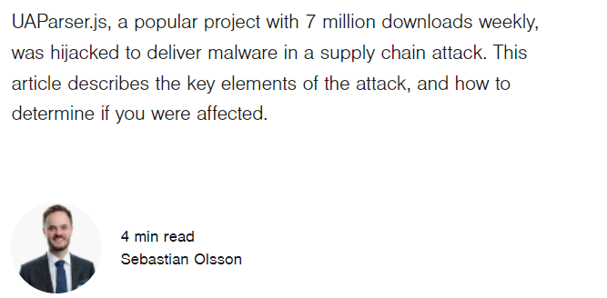
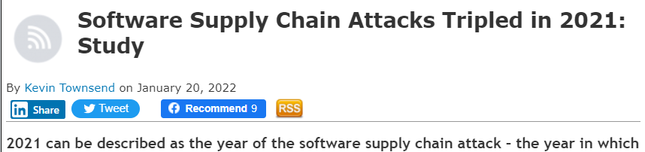
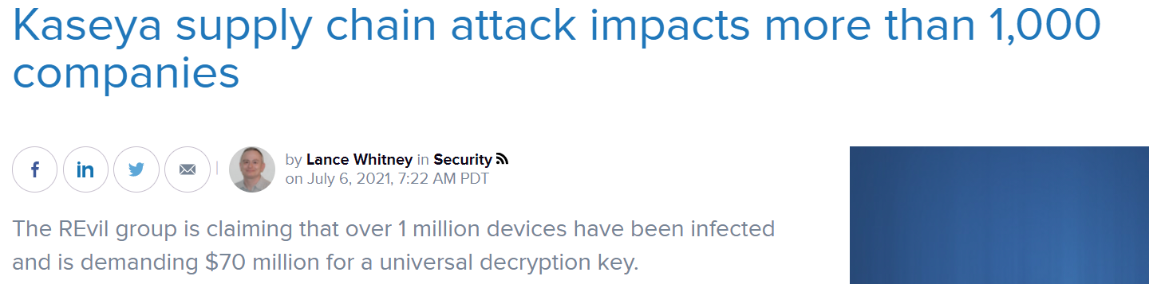
A08 : Software and Data Integrity Failures
New Category.
Focuses on making assumptions related to software updates, critical data, and CI/CD pipelines without verifying integrity.
Notable CWEs are:
CWE-829: Inclusion of Functionality from Untrusted Control Sphere.
CWE-494: Download of Code Without Integrity Check.
CWE-502: Deserialization of Untrusted Data.

Slide 40
A08 : Mitigation
Maintain a proper asset register
Use digital signatures or similar mechanisms to verify software is from a trusted source.
Incorporate software supply chain security tools, such as OWASP Dependency Check or OWASP CycloneDX, in your security plan.
Implement a code & configuration review process.
Ensure your CI/CD pipeline has proper segregation, configuration, and access control to ensure the integrity of the code.
Ensure libraries and dependencies, such as npm or Maven, are consuming trusted repositories.
..

Slide 41
A09 : Security Logging and Monitoring Failures

Slide 42
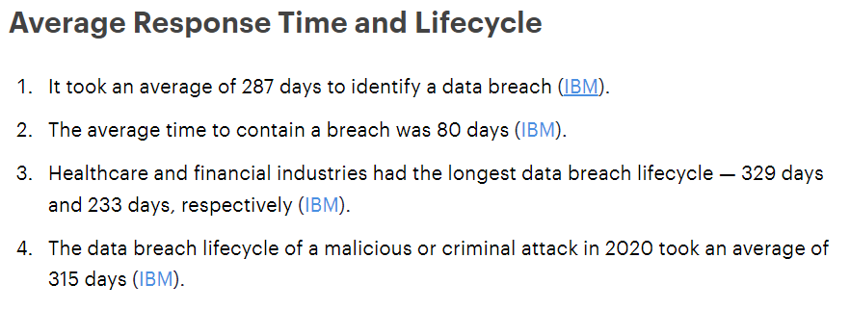
A09 : Security Logging and Monitoring Failures
Attackers rely on insufficient monitoring and timely response to achieve their goals undetected.
How Does it happen?
Auditable events, such as logins, failed logins & other high value transactions are not logged.
Warnings and errors don’t generate adequate log entries.
Logs are not properly managed.
Appropriate alerting thresholds are not set.
Penetration testing exercises/Scans do not trigger alerts.
Application s unable to detect, escalate, or alert for active attacks in real time.
Logs are not monitored properly.

Slide 43
A09 : Mitigation
Ensure all login, access control, and server-side input validation failures are properly logged.
Ensure that logs are generated in a format that log management solutions can easily consume.
Ensure log data is encoded correctly to prevent injections or attacks on the logging or monitoring systems.
Ensure high-value transactions have an audit trail with integrity controls to prevent tampering or deletion, such as append-only database tables or similar.
DevSecOps teams should establish effective monitoring and alerting such that suspicious activities are detected and responded to quickly.
Establish or adopt an incident response and recovery plan, such as National Institute of Standards and Technology (NIST) 800-61r2 or later.

Slide 44
A10 : Server-Side Request Forgery (SSRF)

Slide 45
A10 : SSRF
SSRF flaws occur whenever a web application is fetching a remote resource without validating the user-supplied URL.
In a Server-Side Request Forgery (SSRF) attack, the attacker can abuse functionality on the server to read or update internal resources.​
Reading server configuration such as metadata​
Connecting to internal services like http enabled databases​
Performing requests towards internal services which are not intended to be exposed

Slide 46


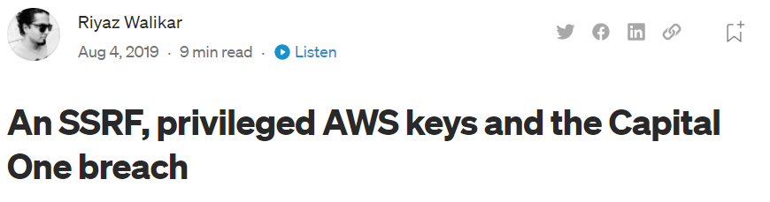
A10 : SSRF
POST /product/stock HTTP/1.0
..
..
stockApi=http://stock.weliketoshop.net/product/stock/check?productId=6
Vulnerable App
Scenario #1
POST /product/stock HTTP/1.0
..
..
stockApi=http://localhost/admin
Scenario #2
POST /product/stock HTTP/1.0
..
..
stockApi=http://169.254.169.254/latest/meta-data/<instance-id>
Notes:
Access control may be implemented from the application side, hence when a request is made from the server side, the checks are ignored.
For disaster recovery, the admin panel may allow un-authenticated access from localhost.
The admin portal may be accessible on a different internal port, not accessible by users.

Slide 47
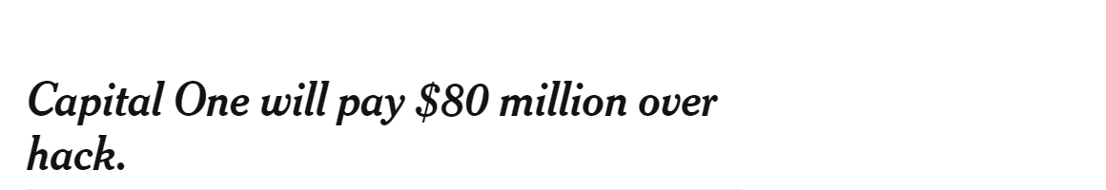
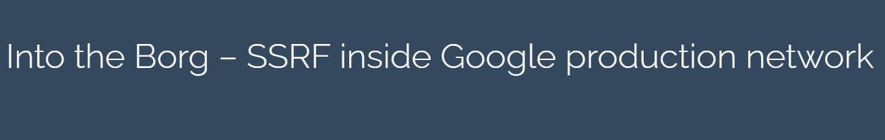
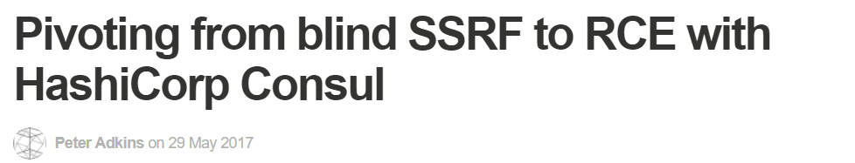
A10 – SSRF

Slide 48
A10 : Mitigation
From Network layer :
Proper segmentation.
Enforce a “deny by default” firewall policy to block all but essential intranet traffic
From Application Layer
Sanitize and validate all client-supplied input data
Enforce the URL schema, port, and destination with a positive allow list
Do not send raw responses to clients
Disable HTTP redirections

Slide 49
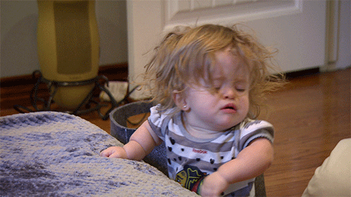
Securing Web Applications

Slide 50
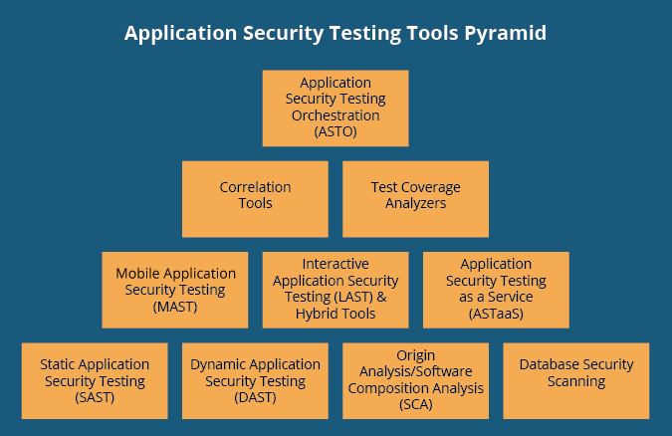
AppSec Testing Tools
Source : https://insights.sei.cmu.edu/blog/10-types-of-application-security-testing-tools-when-and-how-to-use-them/

Slide 51
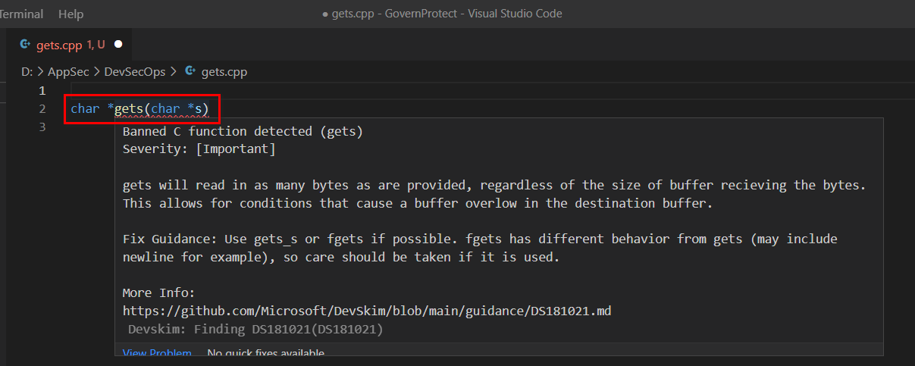
Static Application Testing
Example 1 : Microsoft - DevSkim

Slide 52
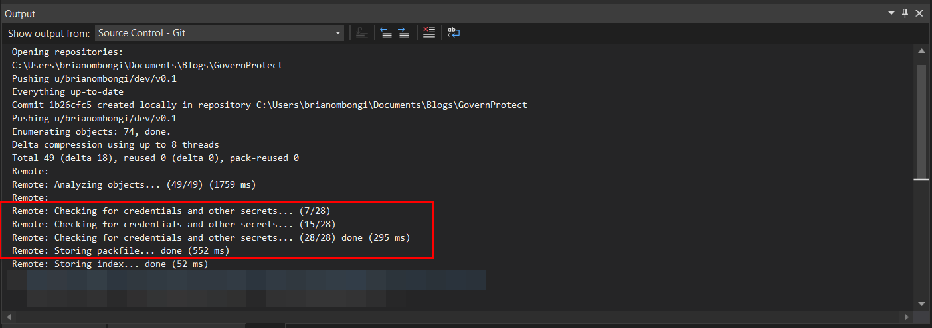
Static Application Testing
Example 2 : Microsoft - CredScan

Slide 53
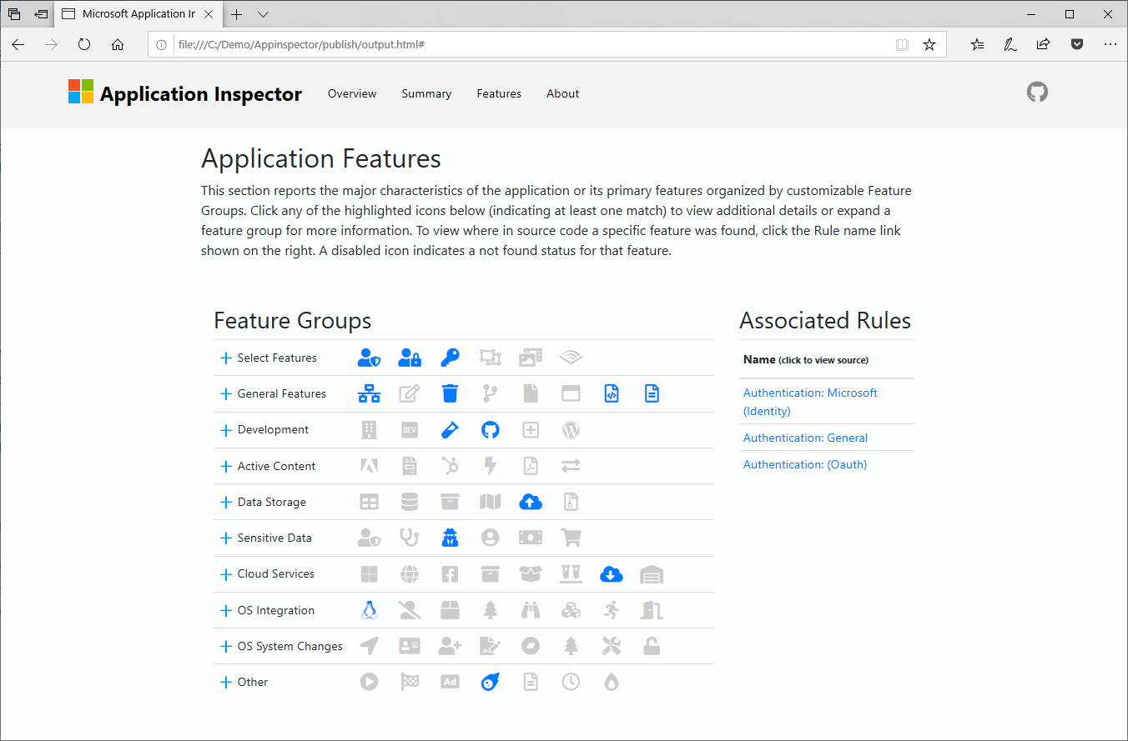
Static Application Testing
Example 2 : Microsoft – Application Inspector

Slide 54
Dynamic Application Testing
BurpSuite
OwaspZap
Nessus
Acunetix
Netsparker
Many
Many
More

Slide 55





Web application design issues
Providing secure configuration
Auditing and logging activity and transactions
Authenticating users
Protecting sensitive data
Handling exceptions
Protecting sensitive data
Web Browser
Firewall
Web Server
Application
App Server
Database
Preventing parameter manipulation
Authenticating and Authorizing identities
Encrypting and hashing sensitive data
Validating input
Preventing Session Hijacking / Cookie Replay attacks
Authorizing users
Notes:
Identify threats

Slide 56
Resources
Microsoft Security Engineering : https://www.microsoft.com/en-us/securityengineering
OWASP : https://owasp.org/Top10/
PortSwigger Academy : https://portswigger.net/web-security
OWASP Juice Shop : https://pwning.owasp-juice.shop/
OWASP WebGoat : https://owasp.org/www-project-webgoat/
DevSkim : https://github.com/microsoft/DevSkim
Application Inspector : https://github.com/microsoft/ApplicationInspector

Slide 57


End
@w33vils
Brian Ombongi

